Slide 1

Ruby on Rails

Slide 2
About today…
Ruby on Rails
Flash Messages
Redirection

Slide 3
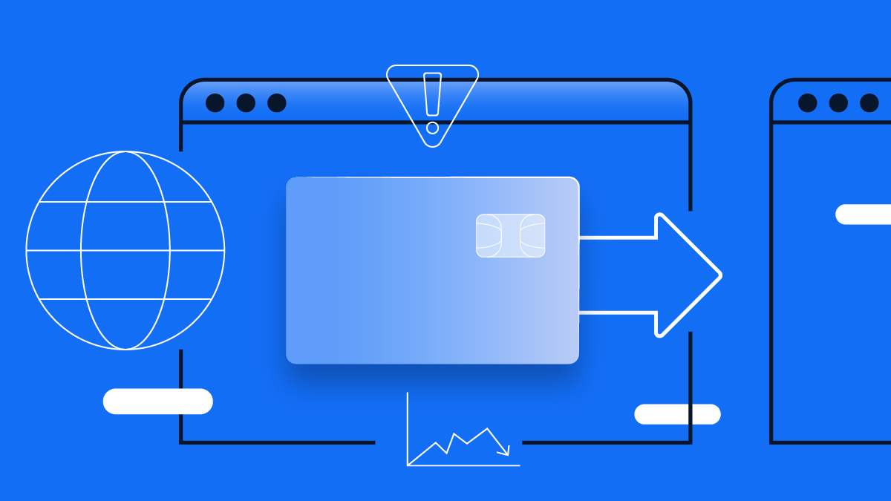
Flash Messages
&
Redirection

Slide 4
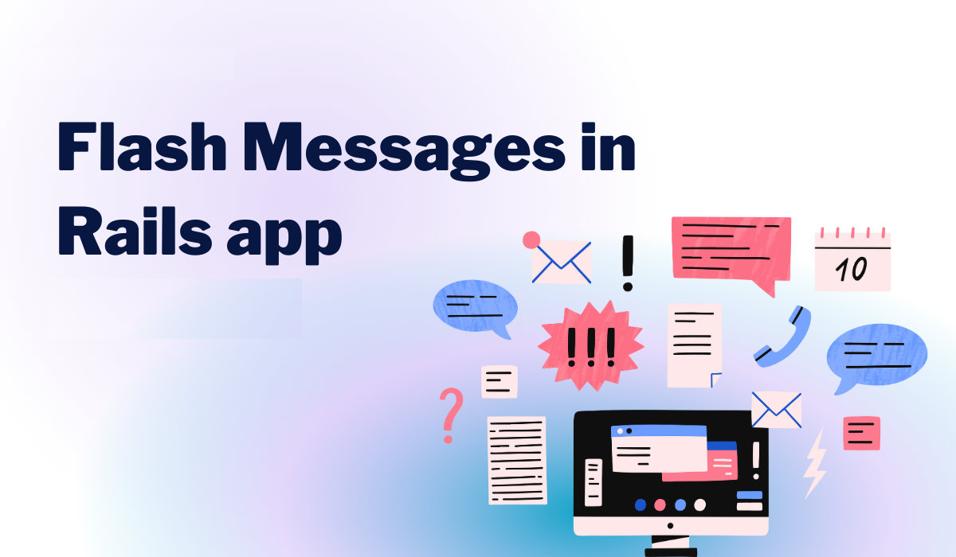

Slide 5
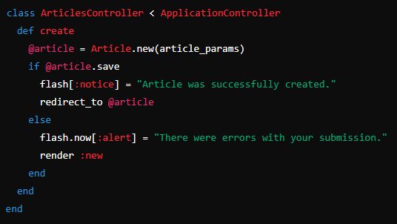
Introduction to Flash Messages
Purpose
Flash messages provide feedback to users
Setting Flash Messages

Slide 6
Introduction to Flash Messages
Purpose
Flash messages provide feedback to users
Setting Flash Messages

Slide 7
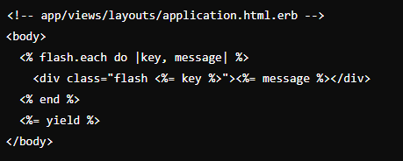
Displaying Flash Messages in Views

Slide 8
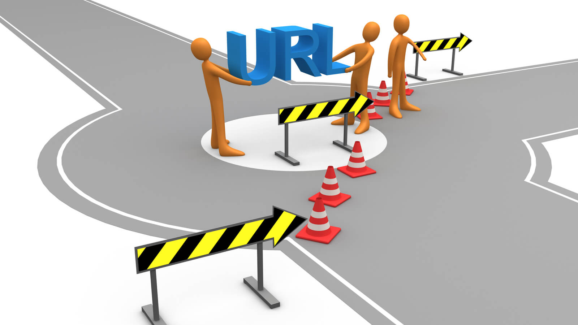
REDIRECTION

Slide 9
What is Redirection?
Purpose
Redirection refers to the process of sending users to a different URL than the one they originally requested
Commonly used after certain actions are performed, such as creating, updating, or deleting data
To provide feedback to users and guide them to the appropriate page

Slide 10
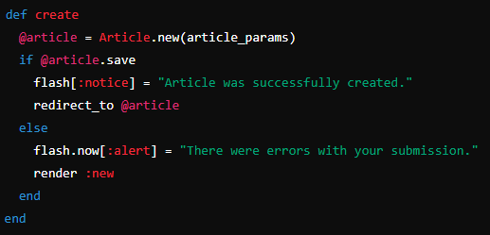
Common Redirection Patterns
Redirect After Create
After successfully creating a new article (@article.save), users are redirected to the newly created article's show page (redirect_to @article)

Slide 11
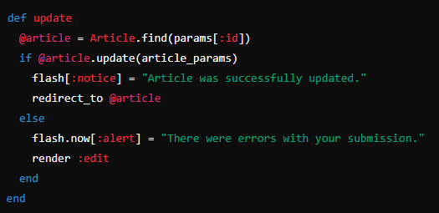
Common Redirection Patterns
Redirect After Update
After updating an article (@article.update(article_params)), users are redirected back to the updated article's show page (redirect_to @article

Slide 12
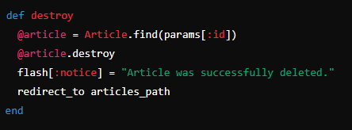
Common Redirection Patterns
Redirect After Delete
After deleting an article (@article.destroy), users are redirected to the list of articles (redirect_to articles_path)

Slide 13
Benefits of Using Redirection
Clarity and Navigation
Helps users understand the outcome of their actions and navigate
seamlessly through the application
Feedback Mechanism
Provides instant feedback through flash messages (flash[:notice],
flash.now[:alert]) to inform users about the success or failure of their actions
Maintains Statelessness
Helps maintain the stateless nature of HTTP requests by avoiding
resubmissions or accidental re-executions of actions

Slide 14


Slide 15
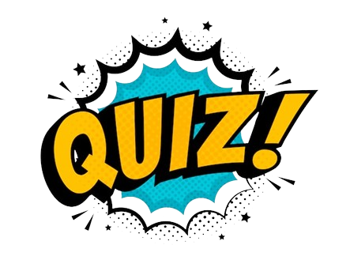
What is the purpose of flash messages in Rails?
Where are flash messages typically displayed in a Rails application?
Which method is used to set a flash message in a Rails controller?
How do you redirect a user to the 'show' page of an article after it has been successfully created?
What happens if you don't set a flash message before redirecting a user?
Which Rails method is commonly used to handle redirection after deleting a record?

Slide 16

Task 1
Implement flash messages to provide user feedback upon creating a new article.
Task 2
Implement redirection after updating an article

